Slide 1
How much is enough?
Confidential
A Limits Discussion
22 January 2020

Slide 2
Administrative Details
Attendees are in listen only mode.
Questions? Please use the Gotowebinar questions feature in the upper right and we will do our best to respond.
For panelist questions after the webinar:
Matt Davis – Matthew_Davis@swissre.com
Jim Redeker - James_Redeker@swissre.com
No CE or loss control credit for listening to today’s discussion.
The slides and audio will be available on E&O Happens soon.

Slide 3
Our Panelists
Matt Davis - Matthew is a Vice President and Claims Manager at Swiss Re Corporate Solutions in Kansas City, Missouri, with 26 years of experience working in and for the insurance industry. He joined Swiss Re in 2004, where he has focused his attention on professional liability claims involving both insurance agents and lawyers throughout the United States and Canada. Matt earned his law degree from the University of Texas.
Jim Redeker - Jim is a Vice President and Claims Manager at Swiss Re Corporate Solutions in Kansas City, Missouri, with 20 years of experience working in and for the insurance industry. He joined Swiss Re in 2002, where he has focused his attention on professional liability claims involving insurance agents throughout the United States. Jim earned his law degree from Washburn University School of Law.

Slide 4
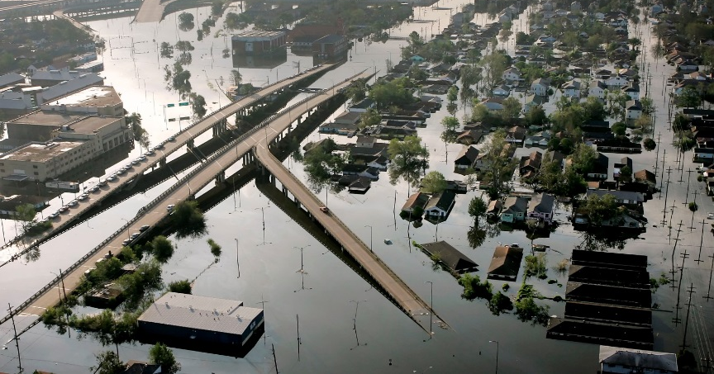
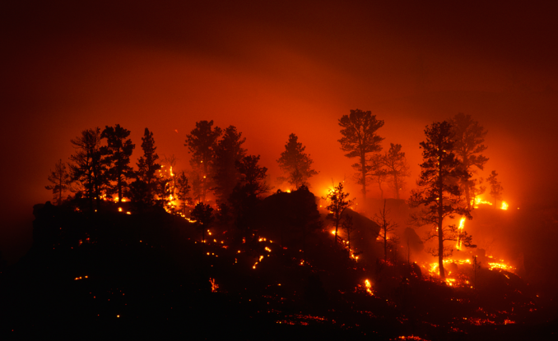
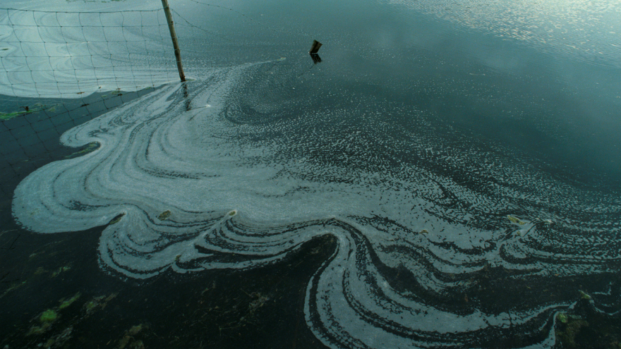
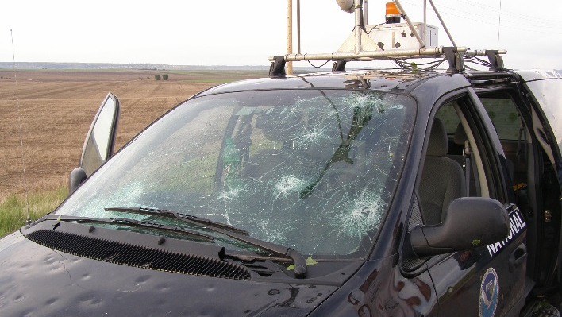
How much is enough? A Limits Discussion
When it comes to picking limits, how much is enough?

Slide 5
Natural Catastrophes

Slide 6
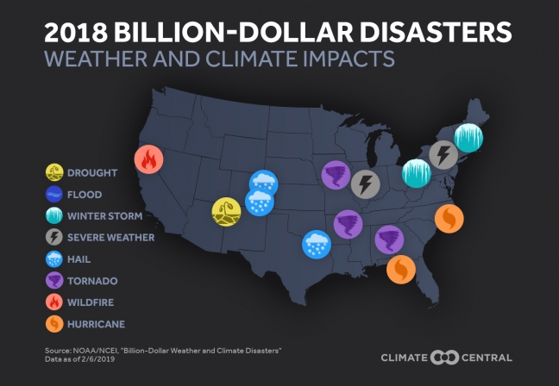
Weather/Climate Losses 2018: A Year of Billion Dollar Disasters

Slide 7
Weather/Climate Losses How many go uninsured?

Slide 8
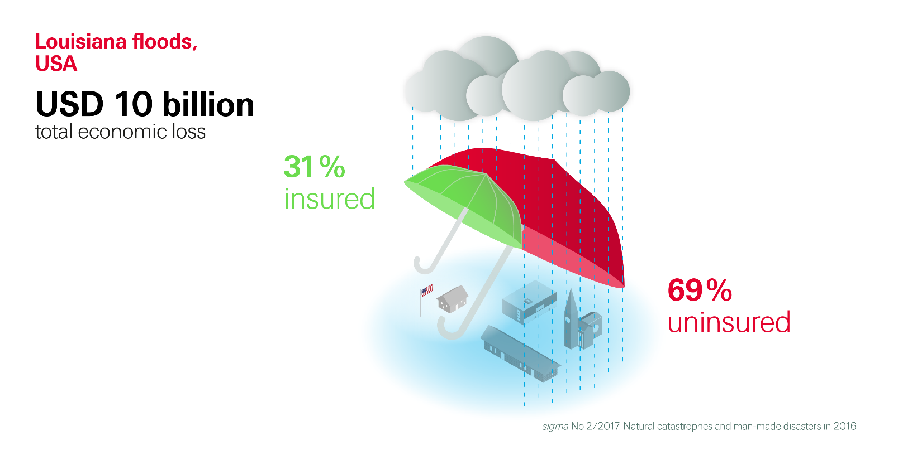
Weather/Climate Losses How many go uninsured?

Slide 9
Weather/Climate Losses How many go uninsured?How many go uninsured?
Agency 1 | 92
Agency 2 | 62
Agency 3 | 49
Agency 4 | 41
Agency 5 | 31
Agency 6 | 29
Agency 7 | 29
Agency 8 | 26
Agency 9 | 26
Agency 10 | 24

Slide 10
Man-Made Disasters

Slide 11
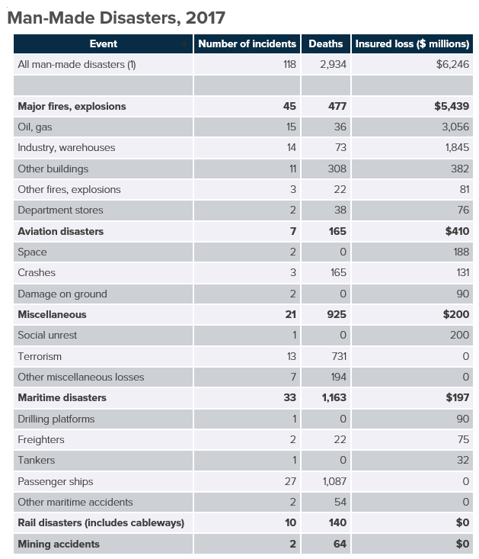
Man-Made Disasters 2017: A Catastrophic Year
Figures are based on events classified by Swiss Re as a catastrophe.

Slide 12
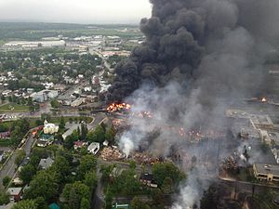
Man-Made Disasters A case study: Lac Mégantic
The Lac-Mégantic rail disaster occurred on July 6, 2013, when an unattended 74-car freight train carrying crude oil rolled down a 1.2% grade and derailed in downtown Lac Mégantic, resulting in fire and the explosion of multiple tank cars.
42 people were confirmed dead, with 5 more missing and presumed dead. More than 30 buildings in the town's center were destroyed, and all but three of the 39 remaining downtown buildings had to be demolished due to petroleum contamination.
Initial newspaper reports described a half-mile blast radius.
Source: Wikipedia “Lac-Mégantic rail disaster”

Slide 13
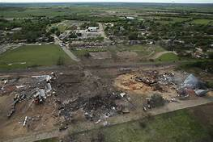
Man-Made Disasters A case study: West Fertilizer Company
On April 17, 2013, an ammonium nitrate explosion occurred at West Fertilizer Company, severely damaging the city of West Texas. 15 people were killed in the explosion, another 160 were injured and 150 buildings were damaged or destroyed.
The explosion created a 93 foot crater where West Fertilizer Company stood, registering as a 2.1 magnitude tremor.
The cause of the fire was never determined.

Slide 14
Man-Made Disasters Nuclear Trucking Verdicts
Texas - $281M
Georgia - $280M
Texas - $260M
California - $178M
New Mexico - $165M
Louisiana - $116M
Texas - $101M

Slide 15
Man-Made Disasters Effect of Nuclear Trucking Verdicts
Carriers are pulling out of or severely cutting back on the amount of General Liability coverage they will offer.
Customers are unable to renew their coverage and agents are left scrambling to replace the coverage.
Replacement coverage is not likely to be as broadly written as the expiring coverage.
There may be a gap in coverage, depending on how long it takes to locate replacement coverage.

Slide 16
Man-Made Disasters Case Studies: Terminix and U-Haul

Slide 17
Man-Made Disasters Case Studies: Indemnity Agreements

Slide 18
High Severity U.S. Agents Claims

Slide 19
U.S. Agents Experience Largest Losses – 2000-2019
Since 2000 Swiss Re Corporate Solutions (or its predecessor entities) have paid $1M+ on more than 100 U.S. Agents claims, including several that surpassed $5M.
Commercial Property, CGL and Workers Compensation coverages produce nearly half of these high severity claims, but the other 50% fall into a number of categories.
Most – but not all – involve commercial lines.

Slide 20
Conclusion How much is enough? – A limits discussion
A thorough analysis of E&O limits should consider:
The policy limits in place for your major customers because, if missing, those limits may define the damage model in your E&O claim
The nature of your customer’s business, e.g., industrial, trucking, manufacturing, and the larger companies to which it provides products and services
The number of insureds located in close proximity to each other, which can set up the potential for a Cat-related or man-made loss creating a serious aggregate loss exposure
Most important: Your agency’s risk appetite in the face of these perils…

Slide 21
Big “I” Related Resources:
“How to Choose Your Agency’s E&O Limit” by Matthew Davis, IA Magazine January 2020

Slide 22
Panelist Contact Information:
Matt Davis - matthew_davis@swissre.com
Jim Redeker - james_redeker@swissre.com

Slide 23
Thank you!

Slide 25
Legal notice
©2019 Swiss Re. All rights reserved. You are not permitted to create any modifications or derivative works of this presentation or to use it for commercial or other public purposes without the prior written permission of Swiss Re.
The information and opinions contained in the presentation are provided as at the date of the presentation and are subject to change without notice. Although the information used was taken from reliable sources, Swiss Re does not accept any responsibility for the accuracy or comprehensiveness of the details given. All liability for the accuracy and completeness thereof or for any damage or loss resulting from the use of the information contained in this presentation is expressly excluded. Under no circumstances shall Swiss Re or its Group companies be liable for any financial or consequential loss relating to this presentation.

