Slide 2
Administrative Details
Attendees are in listen only mode.
Questions? Please use the Gotowebinar questions feature in the upper right and we will do our best to respond.
For panelist questions after the webinar:
Linda Ferguson, CPCU- lindaf@roughnotes.com
Steven Rockey- SteveR@erslaw.com
Matt Davis- matthew_davis@swissre.com
Richard Lund – Richard_lund@swissre.com
No CE or loss control credit for listening to today’s discussion.
The slides and audio will be available on E&O Happens soon.

Slide 3
Our Panelists:
Linda Ferguson, CPCU, is senior vice president of the Technical and Educational Products Division of The Rough Notes Company, Inc. Her 45-year insurance career includes commercial lines underwriting, marketing, product development and management positions in both the field and home offices of national property/casualty insurance carriers.
Steve Rockey a principal in Rockey Stratton, P.S. in Seattle. He has been an attorney for 30-plus years in a civil litigation practice, with an emphasis on defense of professional liability claims, including representing insurance brokers and agents. He is a member of the Washington State Bar Association.
Matt Davis- Matthew R. Davis is a Vice President and Claims Manager at Swiss Re Corporate Solutions in Overland Park, Kansas, with 26 years of experience working in and for the insurance industry. He joined Swiss Re in 2004, where he has focused his attention on professional liability claims involving both insurance agents and lawyers throughout the United States and Canada. Matt earned a B.A. in Economics/English from the University of Kansas and a J.D. from the University of Texas.

Slide 4
Emerging Exposure: Marijuana

Slide 5
Marijuana: Matt Davis
Federal law
Banking industry
Major carriers won’t get involved
Marijuana policy coverage
Marijuana exposures through traditional carriers
Notes:
Matt & Steve

Slide 6
Marijuana: Steve Rockey
Racketeer Influenced and Corrupt Organizations (RICO) case in Washington
If a claim occurs:
Carrier will deny
Customer will deny
Two types of situations:
Insuring a marijuana business
Insuring a business tangentially involved in Marijuana
Notes:
Matt & Steve

Slide 7
Marijuana: Linda Ferguson
Farm
Processing
Wholesale
Retail
Notes:
Matt & Steve

Slide 8
Emerging Exposure: Mold

Slide 9
Mold: Matt Davis
Types of mold claims
Pollution exclusions
More rain fall = more mold claims

Slide 10
Mold: Steve Rockey
Problems deceivingly look small
Pollution exclusion

Slide 11
Mold: Linda Ferguson
Commercial Property
Exclusion
Limited aggregate coverage
Additional limits available at a cost
Personal Lines
Exclusion
Limited coverage subject to insured’s knowledge and action
Additional coverage available at a cost

Slide 12
Emerging Exposure: Drones

Slide 13
Drones: Matt Davis
Personal & commercial uses for drones
FAA registrations
Cost

Slide 14
Drones: Steve Rockey
Coverage concerns
Failure to register w/ FAA
Key exclusions or limitations

Slide 15
Drones: Linda Ferguson
Commercial lines
No drone property coverage
All aircraft bi/pd liability excluded under CG 00 01.
No aircraft pi/ai liability exclusion under CG 00 01.
CG 21 09 mandatory exclusion eliminates all drone liability.
Coverage available by ISO CGL endorsements
Aviation markets can provide both property and liability coverage with aircraft policies.
Personal Lines
As long as drone meets the definition as a model or hobby aircraft coverage is not excluded.
Business use of drone is excluded.

Slide 16
Emerging Exposure: Cyber

Slide 17
Cyber: Matt Davis
Cost of a major cyber attack
Effects on the bottom line
Social Engineering attacks

Slide 18
Cyber: Steve Rockey
E&O problems
New products

Slide 19
Cyber: Linda Ferguson
Excluded from ISO forms
An undefined coverage that is being defined by the insurance companies that are designing the coverage
First party coverage
Third party coverage

Slide 20
Emerged Exposure: Websites

Slide 21
Website: Matt Davis
"Insurance can be confusing, let our experts guide you through the insurance maze.”
Let us be your business partner!" or "... our professionals will work hard to insure that you are fully covered for all those risks that most apply to you“
“we'll produce the most complete plan to safeguard your business."

Slide 22
Website: Steve Rockey
Plaintiffs’ lawyers in E&O claims are quoting from web sites in complaints, depositions, trials, etc.
The web page will make the argument for plaintiff’s attorney
Consumer Protection Act claim
Website advertising should be general and not overpromise

Slide 26
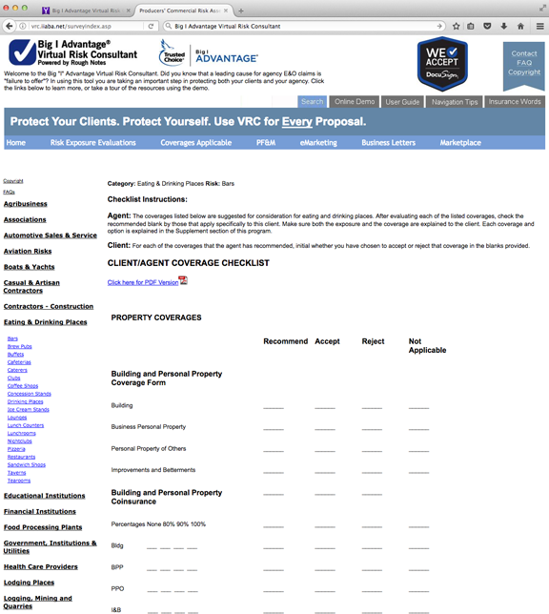

Slide 27
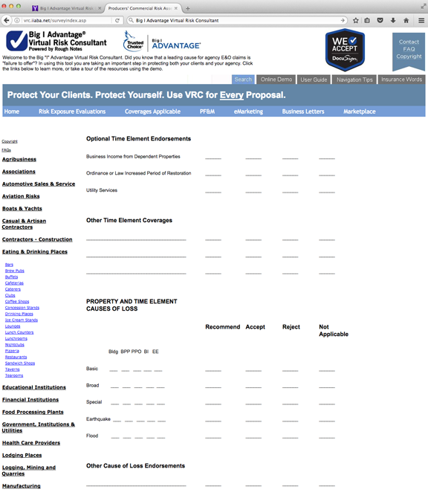

Slide 28
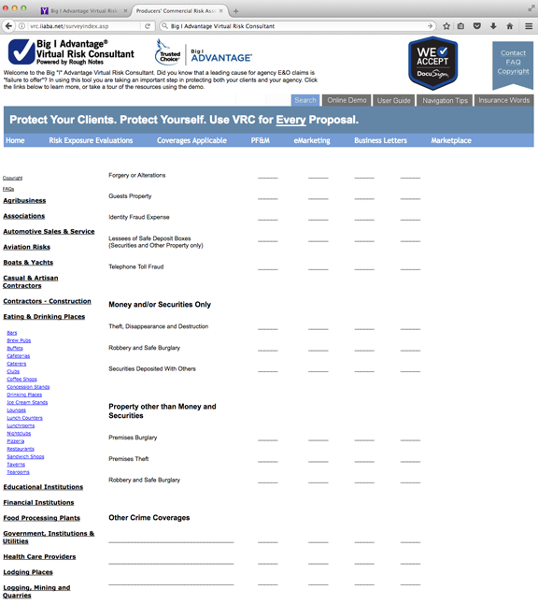

Slide 30
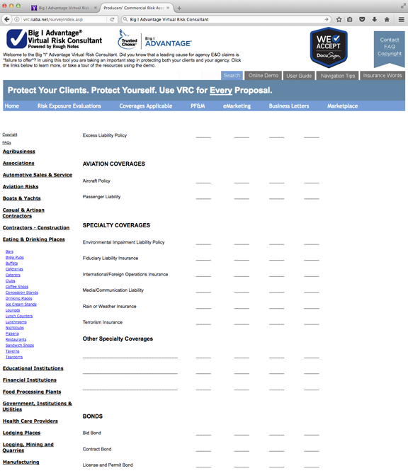

Slide 31
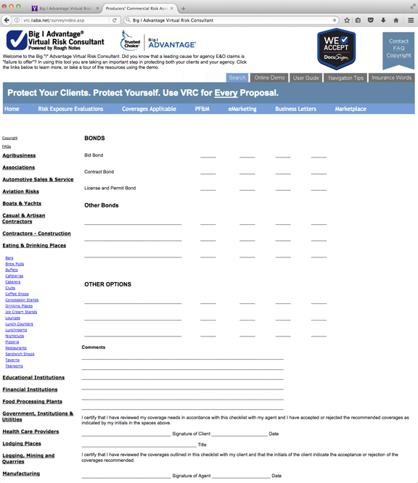

Slide 32
Related Resources:

Slide 33
Resources:
E&O Angle Article: “Play it Safe” Author: Julie Carter
E&O Angle Article: “ Is Mold Growing Your E&O Exposure” Author: David Hulcher
E&O Angle Article: “Look Sharp” Author: Caryn Mahoney
Webinar: “Standard of Care”
Webinar: Is your website doing more harm than good?
Flyer: Website Do’s & Don’ts
E&O Angle Article- “Above and Beyond: When Web Sites Create Additional Duties” Author: Dawn Goeres, JD

Slide 34
Panelist Email Addresses:
For panelist questions:
Linda Ferguson, CPCU- lindaf@roughnotes.com
Steven Rockey- SteveR@erslaw.com
Matt Davis- matthew_davis@swissre.com
Richard Lund – Richard_lund@swissre.com
Please cc: jim.hanley@iiaba.net, Annette_Ardler@swissre.com

