Slide 2
Administrative Details
Attendees are in listen only mode.
Questions? Please use the Gotowebinar questions feature in the upper right and we will do our best to respond.
For panelist questions after the webinar:
Bill Wilson- Bill@InsuranceCommentary.com
Matt Davis- Matthew_Davis@swissre.com
Tim Flanagan- Timothy.Flanagan@rlicorp.com
Jim Hanley- jim.Hanley@iiaba.net
No CE or loss control credit for listening to today’s discussion.
The slides and audio will be available on E&O Happens soon.

Slide 3
Our Panelists:
Bill Wilson- Founder & CEO of Insurance Commentary.com. Bill is the former Associate VP of Education & research and founded the Big “I” Virtual University. He has served as a trainer and speaker for various organizations and has conducted hundreds of technical seminars, workshops and convention presentations. He has authored dozens of articles, manuals and industry trade periodicals. Bill has his CPCU, ARM, AIM and AAM Insurance designations
Matt Davis- Matthew R. Davis is a Vice President and Claims Manager at Swiss Re Corporate Solutions in Overland Park, Kansas, with 26 years of experience working in and for the insurance industry. He joined Swiss Re in 2004, where he has focused his attention on professional liability claims involving both insurance agents and lawyers throughout the United States and Canada.
Tim Flanagan-Tim Flanagan is an underwriting supervisor for RLI in the Specialty Personal Lines department. He has been with RLI working with the Personal Umbrella Program for 10 years, and working with the National IIABA as well as individual IIABA state associations for the past 8. Tim also has a CPCU, ARe and AINS insurance designations.

Slide 4
Bill Wilson, CPCU, ARM, AIM, AAM
Founder & CEO, Insurancecommentary.com

Slide 5
The UM/UIM Exposure
Percentage of uninsured motorists by state
Best states
Worst states
How accurate is this information?
Percentage of underinsured motorists
One example
Why this is important, especially to the selection of UM/UIM limits

Slide 6
Explaining & Selling UM/UIM
Explaining UM/UIM to prospects and insureds
New business
Renewal business (beware carrier communications)
Counseling at claim time
Selling UM/UIM to prospects and insureds
Why individuals and families need it
Why businesses and other organizations need it
By the numbers…

Slide 7
UM/UIM Laws
States with mandatory UM/UIM laws
When must UM/UIM be offered
“Any auto policy” vs.
“Any policy providing auto liability coverage”
Umbrella policies?
BOP or CGL H/NO coverage?
Does everyone understand the law?
Does everyone stay abreast of case law changes?

Slide 8
E&O Caveats (Part 1 of 2)
Agency “minimum limits” procedures
Study: 56% of UM/UIM selection/rejection forms likely don’t comply with the law
“Standard” UM/UIM forms
Form mandated by DOI?
Proprietary carrier forms?
Other forms
(cont’d)

Slide 9
E&O Caveats (Part 2 of 2)
Never, EVER sign a declination form
Be wary of form highlighting and flagging
Have named insured sign and date
Show lower UM/UIM limits on form?
Record retention (don’t rely on carrier)
UM/UIM “stacking”

Slide 10
Matthew Davis, Claims Manager, Vice President
Swiss Re Corporate Solutions

Slide 11
What Can Possibly Go Wrong?
You don’t make the pitch for UM/UIM on your customer’s umbrella policy
You aren’t convincing enough
You don’t get the customer to sign a rejection of UM/UIM umbrella coverage
You secure the rejection, then put it in a ‘safe place’ (that can never be located)

Slide 12
E&O Case Study #1
“To Whom It May Concern:
Please be advised that I represent JOHN DOE, and his wife ..., with regard to serious injuries JOHN DOE received when operating a motorcycle on or about ... 2017. ... Because JOHN DOE's business was insured through AGENCY, and because AGENCY holds itself out as highly skilled insurance experts, JOHN DOE transferred his personal insurance ... to AGENCY. In doing so, JOHN DOE relied upon AGENCY's expertise to procure proper insurance that would protect him and his family in the event of an accident. JOHN DOE readily admits that he is unsophisticated in insurance-related matters. …”

Slide 13
E&O Case Study #1 (continued)
“AGENCY recommended that JOHN & JANE DOE purchase a personal umbrella policy. The umbrella policy was written so as not to provide UIM coverage on top of the JOHN & JANE DOE underlying UIM coverage. Given the minimal cost involved in writing the umbrella to extend to UIM coverage, compared to the added risk to the insured in not doing so, an umbrella policy should not be written as it was to JOHN & JANE DOE. This is especially true where the insured is known to be operating a motorcycle where injuries can be particularly problematic and underlying limits insufficient. I am aware that UIM coverage is not statutorily mandated but the DOEs did not transfer their personal coverages to AGENCY for the sake of obtaining statutory minimum coverages. …”

Slide 14
E&O Case Study #1 (continued)
"[Y]our liability insurer must understand that JOHN DOE's injury claim far exceeds the $1 million in coverage that would have been available if the policy was written so as to properly protect your insured...“
"[Y]our website attests to AGENCY holding itself out as an insurance expert. Your website will be critical evidence in the civil litigation if this matter cannot be amicably resolved short of suit. Therefore, under no circumstance, should your website be destroyed, altered or modified in any way..."

Slide 15
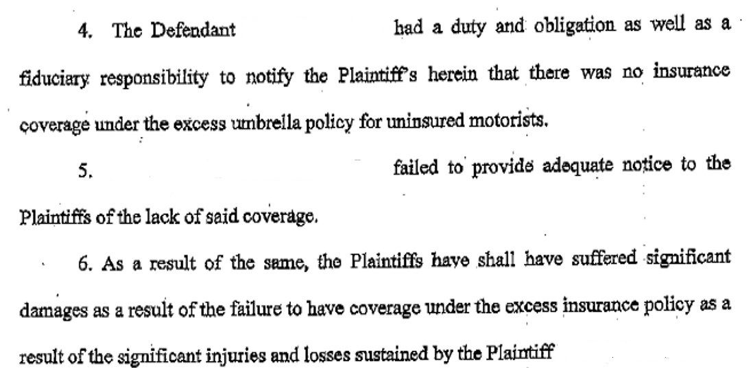
E&O Case Study #2

Slide 16
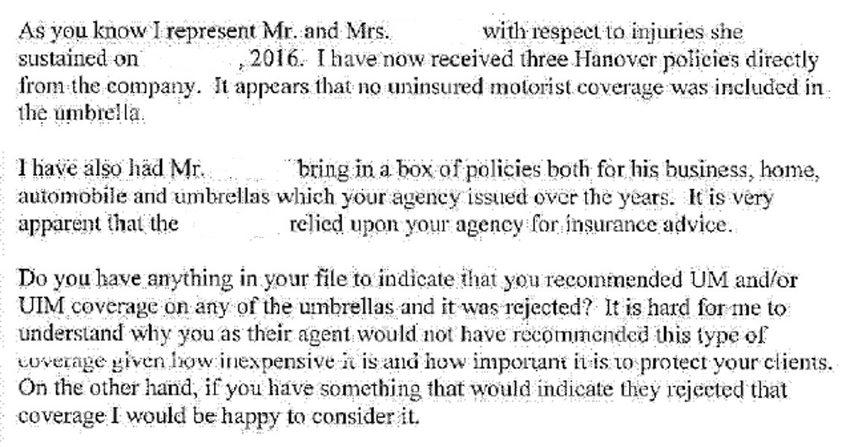
E&O Case Study #3

Slide 17
E&O Takeaways
These claims are on the rise in # and severity
In many cases ‘The Statutory Minimum’ is not good enough because plaintiff will testify you claimed expertise (orally or by website)
You should:
Make the pitch for higher UM/UIM limits (umbrella)
Make it well, including the cost of saying “No”
Carefully preserve a record of the rejection

Slide 18
Timothy Flanagan, CPCU, ARe, AINS
Supervisor, PUP Underwriting
RLI Insurance Company

Slide 19
RLI - Excess UM/UIM
Optional Coverage as part of the umbrella offering (All States)
Mandatory Offering in several states (FL, LA, WV, NH, VT) which require the completion of a separate form designed using the states guidelines.
LA, WV, NH, VT require an offering of limits equal to the limit of liability (i.e. $3 million umbrella, $3 million in Excess UM/UIM)
General rating is on a per driver in household basis (different if in one of the mandatory offer states listed above)
Hard to price for. Excess UM/UIM is essentially protection against an unknown parties’ ability to drive safely. When you don’t know who may hit you, it can be difficult to know what to charge.

Slide 20
RLI - Excess UM/UIM (cont’d)
Coverage is excess over the underlying UM/UIM coverage.
Must maintain underlying UM/UIM limits of at least the agreed upon underlying auto liability limits, or coverage would be excluded.
Does not cover property damage

Slide 21
Reasons to Offer
Important coverage for insured to round out their insurance portfolio
# of Uninsured/Underinsured drivers are increasing
Avoid a ‘failure to offer’ E&O claim

Slide 22
Reasons to Purchase
If you are willing to pay money for liability insurance (protection for injury to someone else) wouldn’t you want to provide yourself the same assurances?
Gives piece of mind when there is uncertainty as to whether other drivers are carrying adequate liability insurance
Watch the amount of advertisements in your area for insurance companies selling state minimum limits.
Increase in the cost of medical care

Slide 23
Additional Info and Links
RLI – Excess UM/UIM Video
https://www.youtube.com/watch?v=TqbmJLdqQNk
Other General RLI marketing material and tools can be found at www.iiaba.net/rli
Personal Umbrella available through your State Association - https://www.independentagent.com/Products/Insurance/Umbrella/SiteAssets/Pages/Your%20State%20Adminstrator/YourStateAdminstrator/back.final.pdf
Sample Decline Form
Sample Marketing Flyer

Slide 24
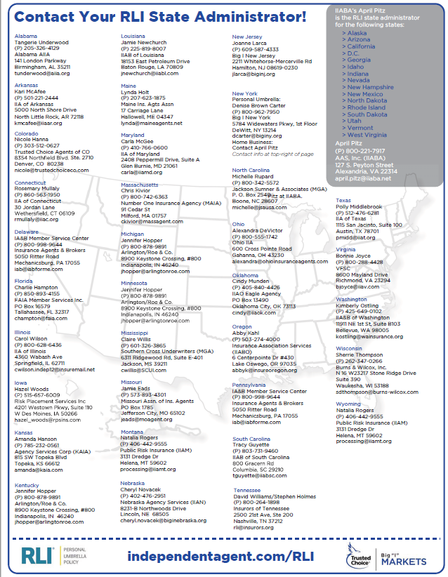

Slide 26
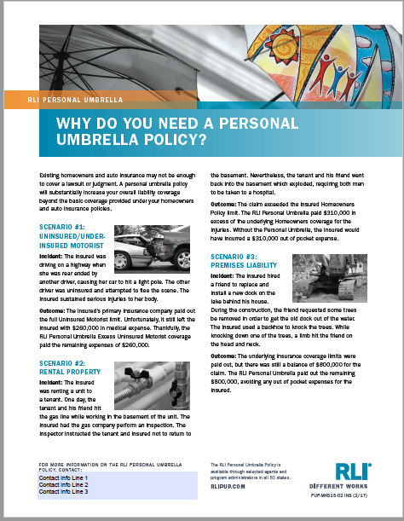

Slide 27
Related Resources:
1. UM/UIM Coverage: Headaches and Opportunities- Crystal Ivy
2. Why You Need to Offer Excess UM/UIM to Every Client- April Shrewsbury
3. UM/UIM: It’s Not Just Alphabet Soup- Nicole Yarborough
4. "A Rejection Form, a rejection form, My Kingdom for a rejection form!" - Richard Lund

Slide 28
Panelist Contact Information:
Bill Wilson- Bill@InsuranceCommentary.com
Matt Davis- Matthew_Davis@swissre.com
Tim Flanagan- Timothy.Flanagan@rlicorp.com
Jim Hanley- jim.Hanley@iiaba.net

Slide 29
Thank you!

